Slide 1
Data Structures

Slide 2
Agenda
Quick Sort – Time Complexity, Random Pivot
Sliding Window
Two Pointer approach
String Class and functions
String Pool
Artistic Pattern

Slide 3
Quick Sort – Time Complexity

Slide 4
Quick Sort – Time Complexity

Slide 5
Quick Sort – Time Complexity

Slide 6
Quick Sort – Time Complexity

Slide 7
Quick Sort – Time Complexity

Slide 8
Quick Sort – Time Complexity
https://www.geeksforgeeks.org/analysis-of-different-sorting-techniques/

Slide 9
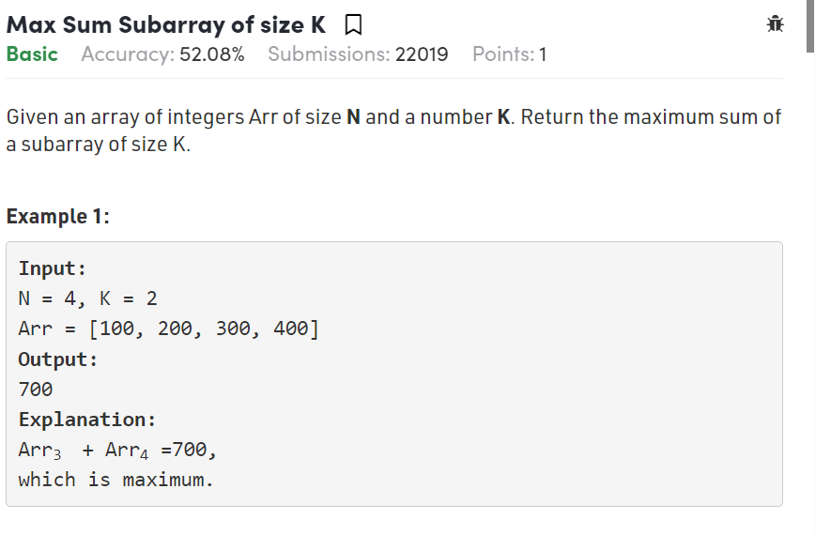
Sliding Window

Slide 10
Sliding Window

Slide 11
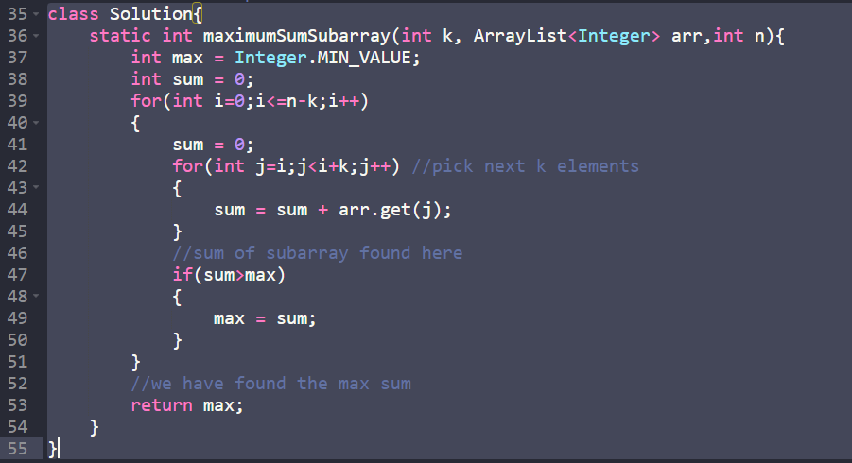
Sliding Window
Question link:
https://practice.geeksforgeeks.org/problems/max-sum-subarray-of-size-k5313/1/

Slide 12
Sliding Window

Slide 13
Sliding Window

Slide 14
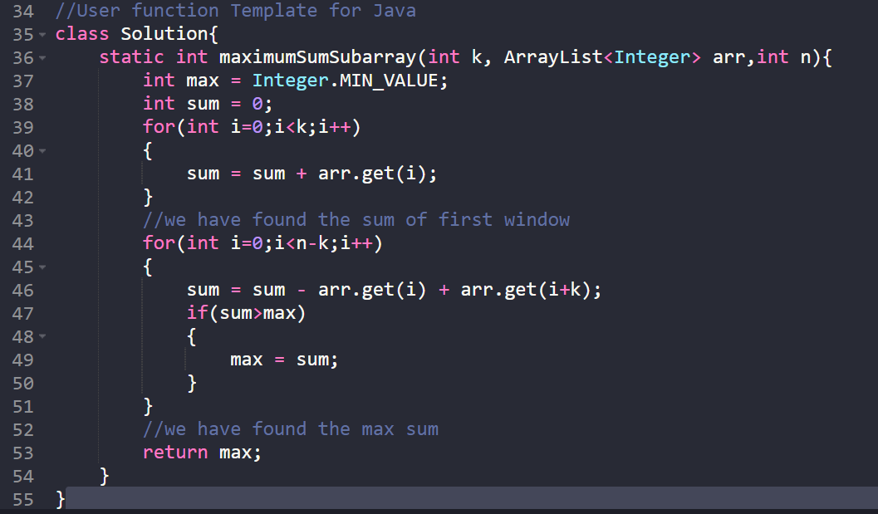
Sliding Window

Slide 15
Two Pointer approach

Slide 16
Two Pointer approach

Slide 17
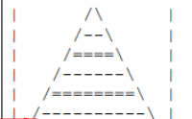
Artistic Pattern

Slide 18
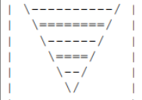
Artistic Pattern

Slide 19
String Class

Slide 20
String Pool

Slide 21
THANK YOU

